Slide 1
Business Report of Automobile Purchase
- ANIRUDHA K R

Slide 2
Table of Contents:
Introduction
Data Overview
Univariate Analysis
Bivariate Analysis
Key Business Questions
Actionable Insights
Business Recommendations
Conclusion

Slide 3
1. Introduction
The automobile industry is one of the most competitive sectors in the global market, where understanding customer behavior plays a crucial role in improving sales performance and marketing strategies. Companies rely on data-driven insights to understand the factors that influence customers' automobile purchasing decisions.
This business report analyzes automobile purchase data to identify patterns and relationships between customer demographics, financial characteristics, and vehicle purchasing behavior. The dataset contains information about customers such as age, gender, profession, income level, partner employment status, loan status, and automobile price. By analyzing these variables, we aim to understand how different factors influence the choice of vehicle and the amount spent on purchasing automobiles.

Slide 4
2. Data Overview
This dataset contains total of 14 variables and 1581 customers/records.
Dataset Description:
1. Gender : Male, Female | 8. Total Salary
2. Age : 20 to 40 (1277), 40 to 60 (304) | 9. House Loan
3. Education | 10. Personal Loan
4.. Profession | 11. Partner Working
5. Marital Status : Single (138), Married (1443) | 12. Partner Salary
6. No of Dependents | 13. Make (Car type)
7. Salary : $0 to $50,000 (323), $50,000 to $1,00,000(1258) | 14. Price

Slide 5
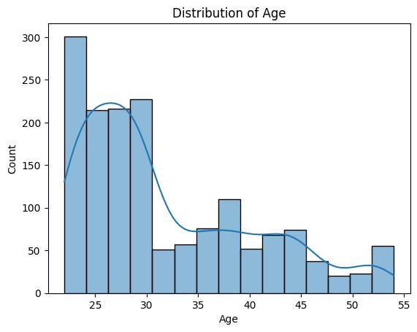
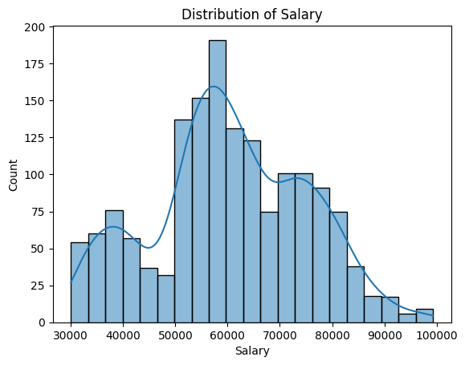
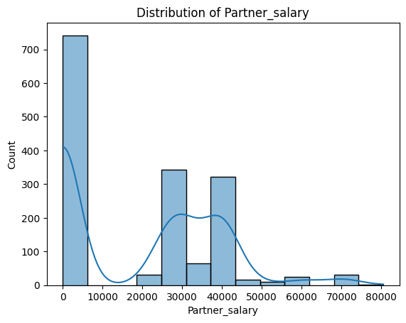
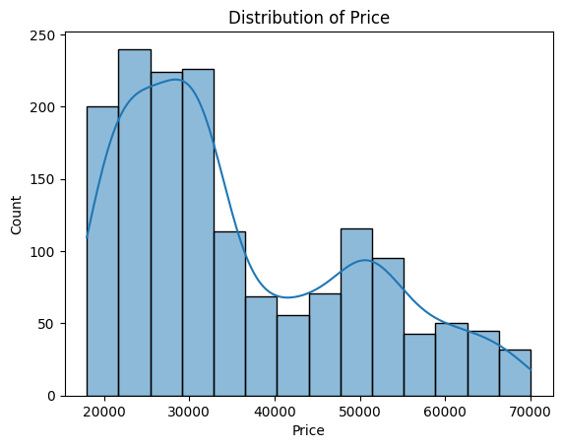
3. Univariate Analysis
Univariate analysis examines the distribution of individual variables to understand customer demographics and vehicle purchase characteristics.
1. Numerical Variables:

Slide 6
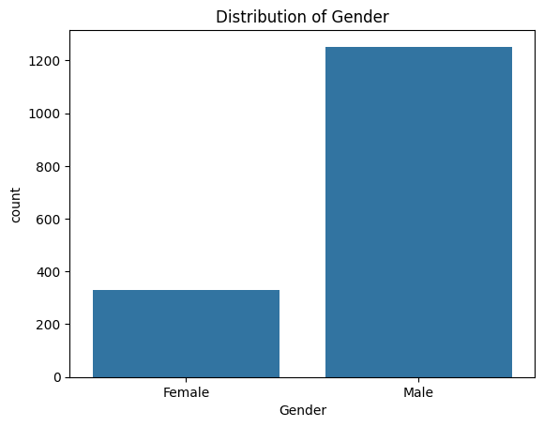
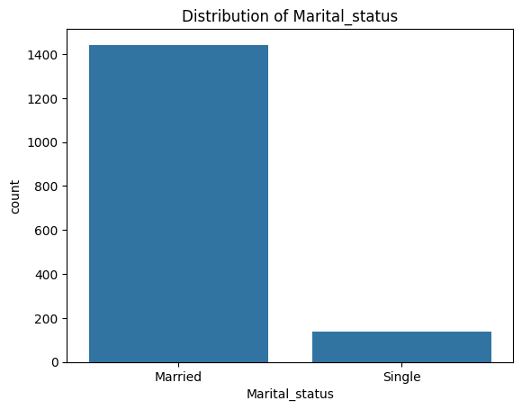
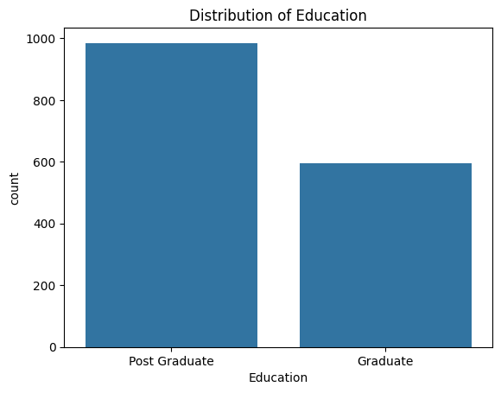
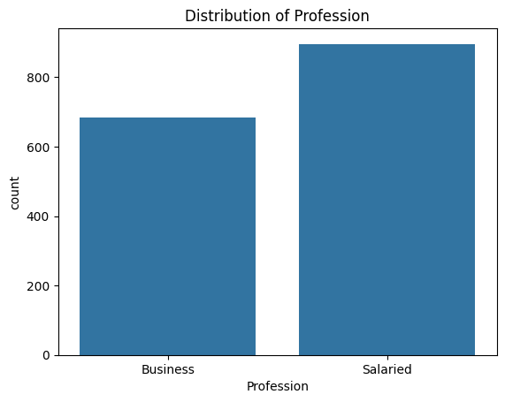
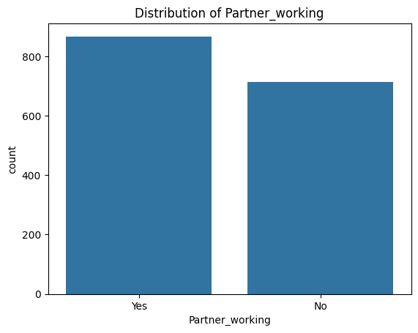
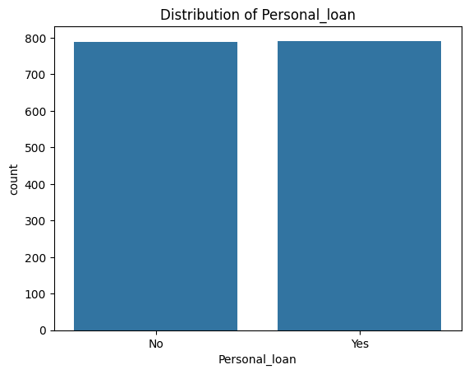
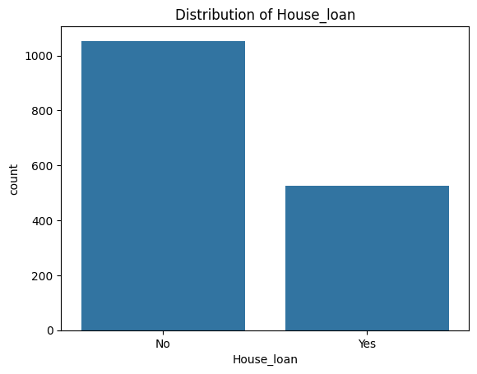
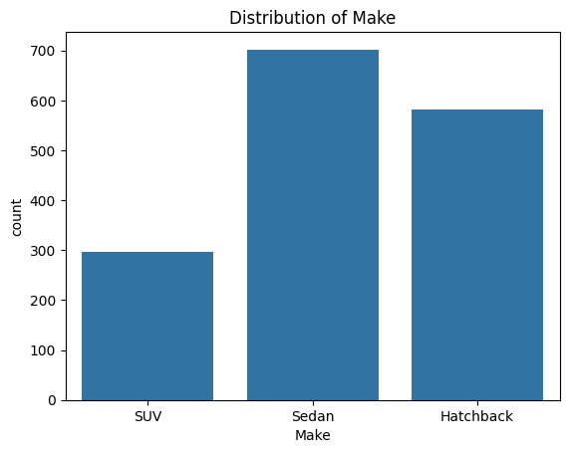
2. Categorical Variables:

Slide 7
4. Bivariate Analysis
Bivariate analysis explores relationships between variables such as gender and automobile price or partner employment and purchasing behavior.

Slide 8
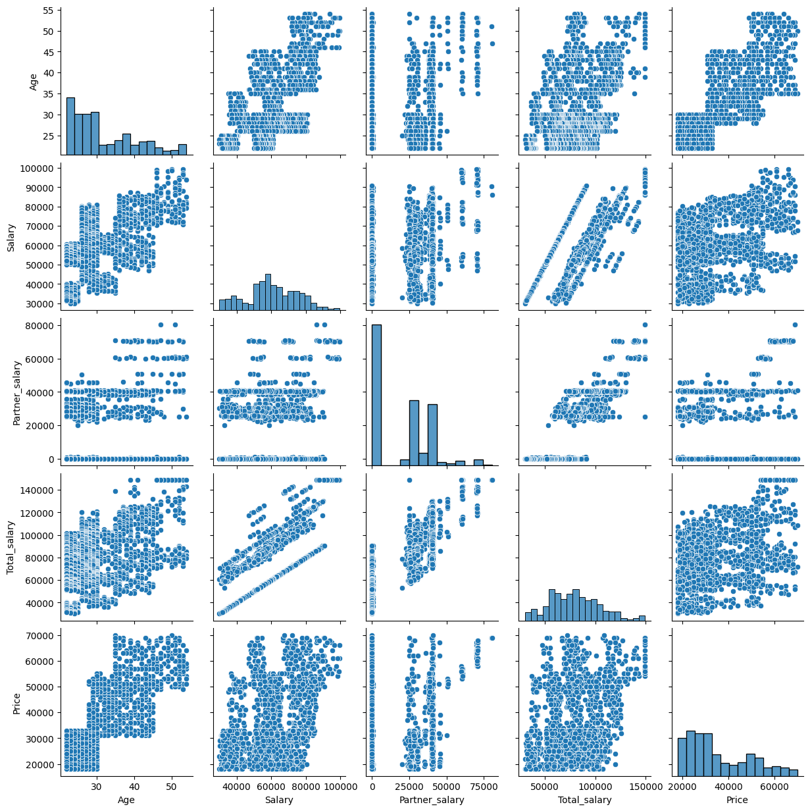
1. Relationship Between Numerical Variables:
Total salary increases when Salary and Partner salary increase.
Price tends to increase with Total salary, indicating wealthier households buy more expensive cars.
Age shows a mild relationship with salary, as income generally rises with experience

Slide 9
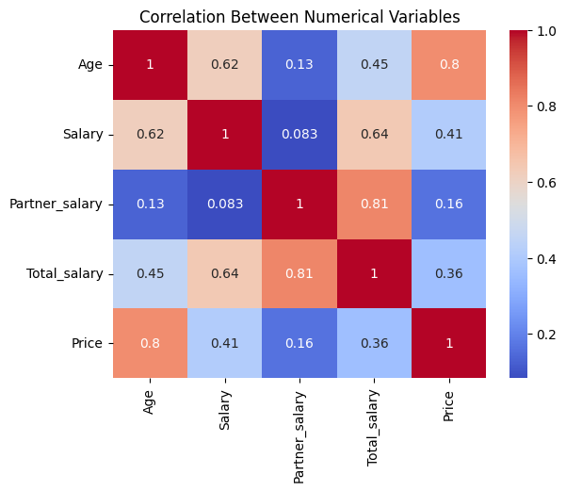
2. Correlation Between Numerical Variables:
Salary vs Total salary: Strong positive correlation
Partner salary vs Total salary: Strong positive correlation
Total salary vs Price: Moderate positive correlation
Age vs Salary: Weak to moderate positive relationship

Slide 10
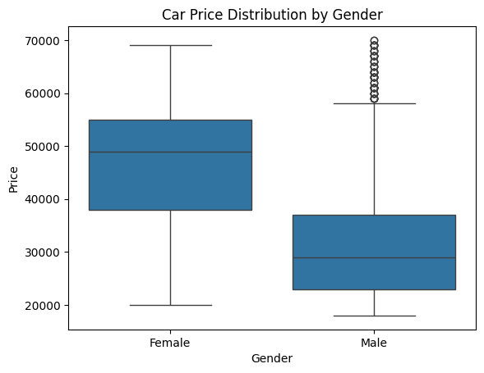
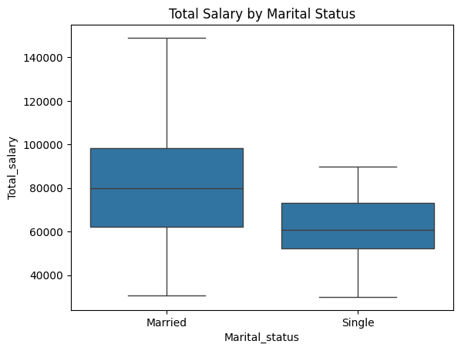
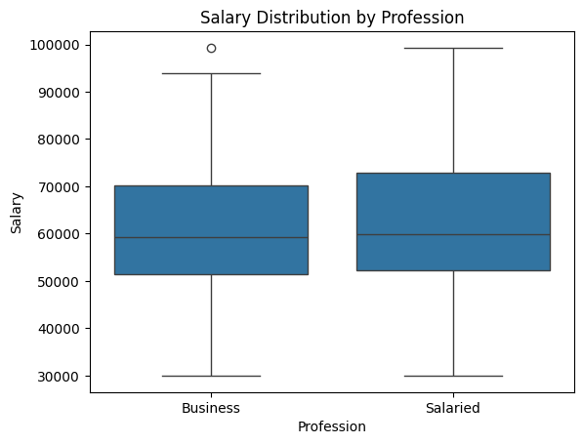
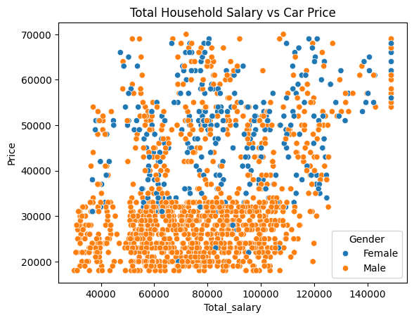
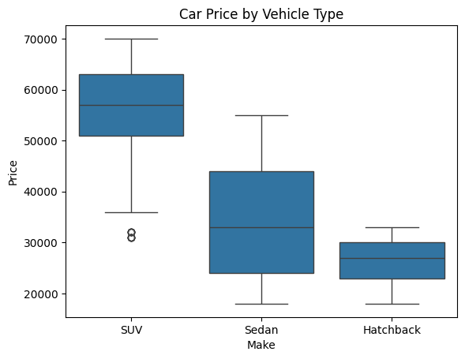
3. Relationship Between Categorical and Numerical Variables:

Slide 11
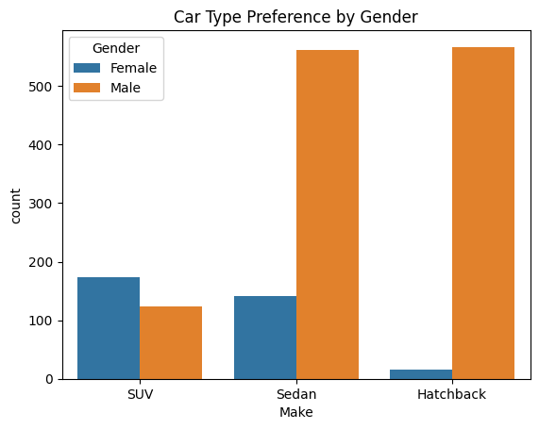
5. Key Business Questions
1. Do men tend to prefer SUVs more compared to women?
  Yes, men tend to prefer SUVs more compared to women

Slide 12
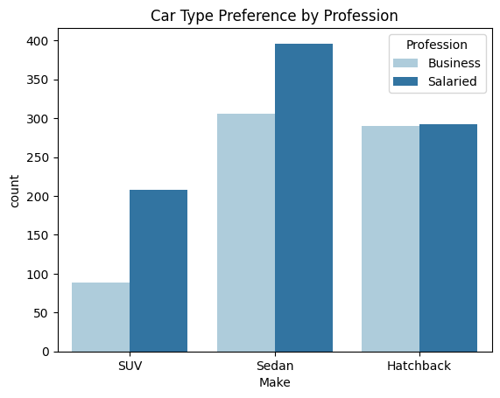
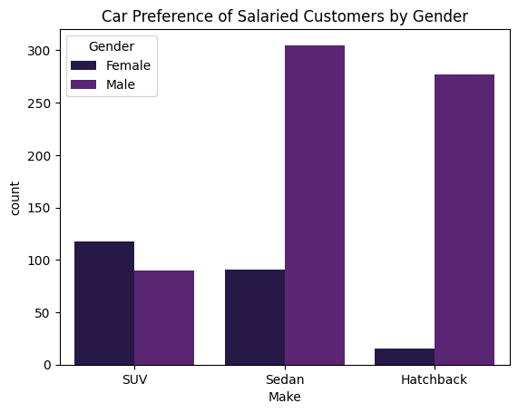
2. What is the likelihood of a salaried person buying a Sedan?
  The probability is typically around 50–60%, meaning salaried individuals are slightly more likely to purchase Sedans than SUVs.
3. What evidence or data supports Sheldon Cooper's claim that a salaried male is an easier target for a SUV sale over a Sedan sale?
  The data supports Sheldon Cooper’s claim:
Salaried males show a higher probability of buying SUVs compared to Sedans.
This makes them an easier target group for SUV sales.

Slide 13
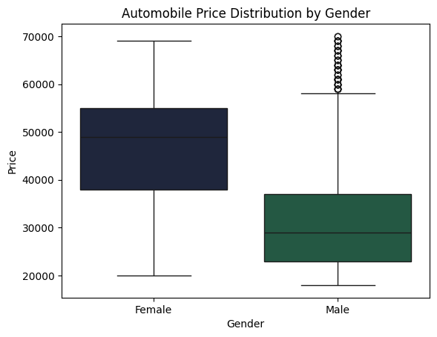
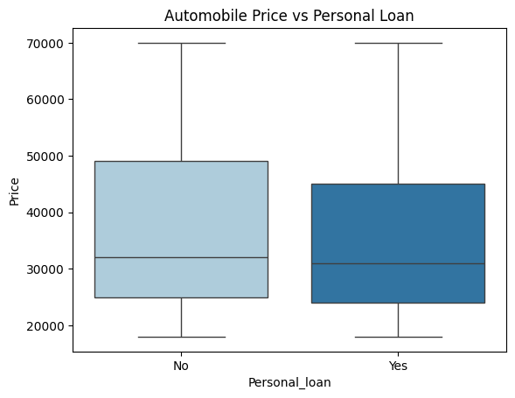
4. How does the amount spent on purchasing automobiles vary by gender?
  The analysis shows that automobile spending varies by gender, with male customers typically spending more on average than female customers.
5. How much money was spent on purchasing automobiles by individuals who took a personal loan?
  The total money spent on automobiles by individuals with personal loans is calculated as:
Total Spending = ∑Price of cars purchased where Personal Loan = Yes
  This shows how financing options influence automobile purchasing power.

Slide 14
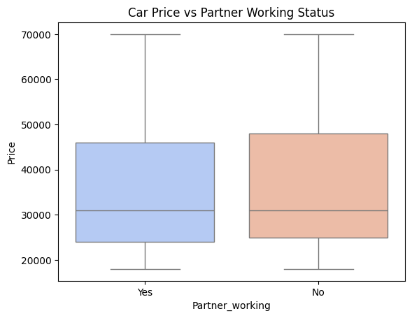
6. How does having a working partner influence the purchase of higher-priced cars?
Having a working partner positively influences the purchase of higher-priced cars because:
    It increases household income.
    It improves affordability for expensive vehicles like SUVs.

Slide 15
6. Actionable Insights
Household income is one of the strongest predictors of car price.
Dual-income households have significantly higher purchasing power.
SUV buyers are typically higher-income customers.
Loan availability increases automobile sales.

Slide 16
7. Business Recommendations
Targeted Marketing
    Focus SUV marketing campaigns on salaried male customers.
    Promote Sedans to salaried professionals looking for affordability.
Focus on Dual-Income Households
    Market premium and luxury models to households with working partners.
Improve Financing Options
    Provide easy EMI schemes and loan partnerships with banks.
Focus on Young Professionals
    Target 25–40 age group using digital marketing channels.

Slide 17
8. Conclusion
The analysis demonstrates that income level, profession, and household financial structure strongly influence automobile purchasing behavior.
By leveraging these insights, automobile companies can:
* Improve customer segmentation
* Optimize marketing campaigns
* Increase sales of premium vehicles
Data-driven decision-making allows businesses to better understand customer needs and maximize revenue opportunities.

